Slide 1
Cardio Good Fitness Project

Slide 2
Project Description & Objective
Key steps required –
Import the dataset and understand the structure.
Extract basic observations using Exploratory Data Analysis methods.
Identify differences between customers of each product.
Explore relationships between different attributes of customers
Expected outcome –
Come up with a customer profile (characteristics of a customer) of the different products.
Perform uni-variate and multi-variate analyses.
Generate a set of insights and recommendations that will help the company in targeting new customers.
The objective is to perform a preliminary data analysis for the dataset – “CardioGoodFitness.csv”.
Dataset contents:
The data is for the customers of the treadmill products of a retail store called Cardio Good Fitness. It contains following variables –
Product – the model number of treadmill
Age – in no.of years, of the customer
Gender – of the customer
Education – in no.of years, of the customer
Marital Status - of the customer
Usage - Avg. # times the customer wants to use the treadmill every week
Fitness - Self rated fitness score of the customer (5 - very fit, 1 - very unfit)
Income - of the customer
Miles- expected to run

Slide 3
Data Summarization
Variables | Datatype | Values
Product | Categorical | 3 unique values : TM195, TM498, TM798
Age | int64 | Range : 18 to 50 (years)
Gender | Categorical | 2 unique values : Male, Female
Education | int64 | Range : 12 to 21 (years)
MaritalStatus | Categorical | 2 unique values : Single, Partnered
Usage | int64 | Range : 2 to 7 times in a week
Fitness | int64 | Range : 1 to 5
Income | int64 | Range : 29562 to 104581
Miles | int64 | Range : 21 to 360
No.of Rows | 180
No.of Columns | 9
Note: There are no missing or garbage values in the dataset.

Slide 4
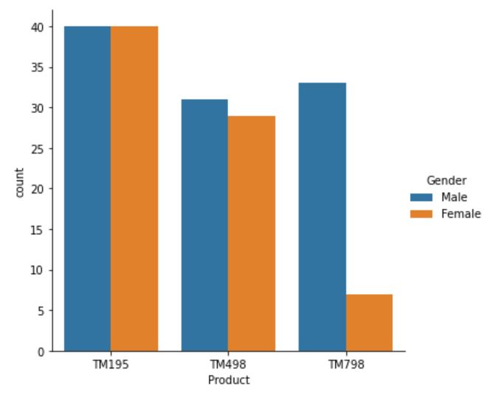
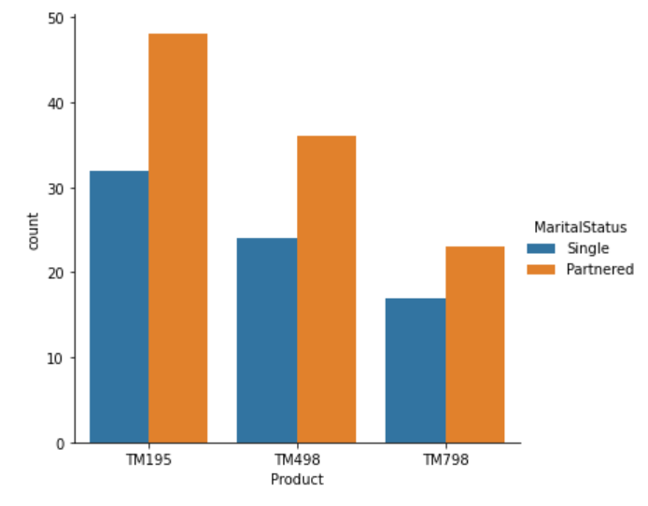
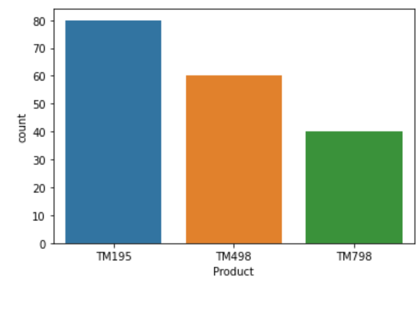
Exploratory Data Analysis - In this data, there are variables like Gender & MaritalStatus that affect the sale of Treadmill products.
Observations:
TM195 is the most sold product.
There are more Male customers than Female.
TM195 is the most preferable choice for both Male & Female customers
TM798 is mostly bought by Male customers
Partnered customers tend to buy more treadmill products than Single ones.

Slide 5
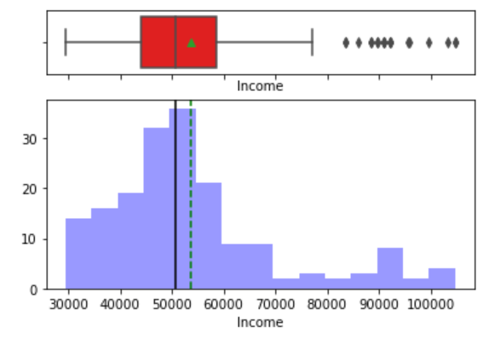
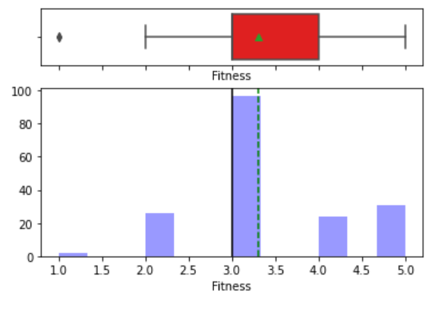
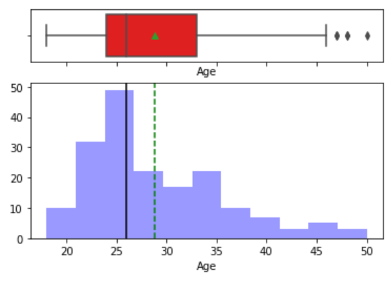
Exploratory Data Analysis Univariate
Observations:
Majority of customers income lies in range of 40K – 60K, indicating a decent earning customer base.
50% of customers have income approximately equal to the average income (~53K).
There are some outliers in Income graph, indicating some customers with high income range.
Average fitness ratings of customers is 3.3 and 50% of customers have fitness rating > 3.
Majority of customers are aged between 21 to 35 years, with some customers > 35 yrs of age.

Slide 6
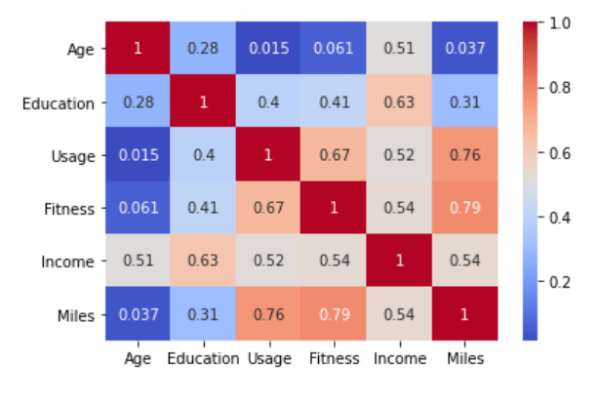
Exploratory Data Analysis - Correlation matrix
Observations:
Fitness, Miles & Usage have high correlation with each other.
Income has a good correlation with Education, obviously indicating – Higher the education, higher is the income.
Income is also correlated moderately with all the other variables – Usage, Fitness, Miles & Age.

Slide 7
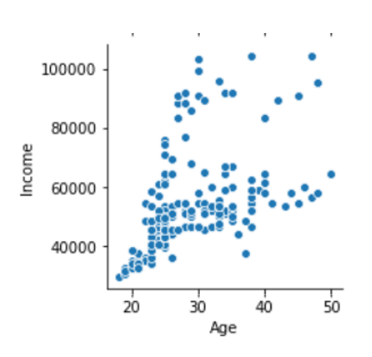
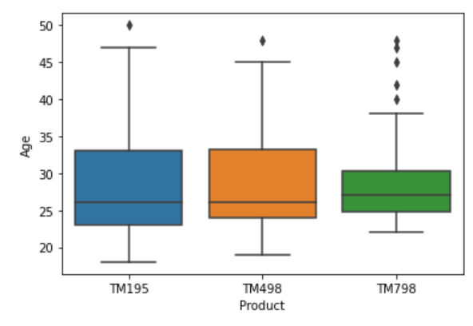
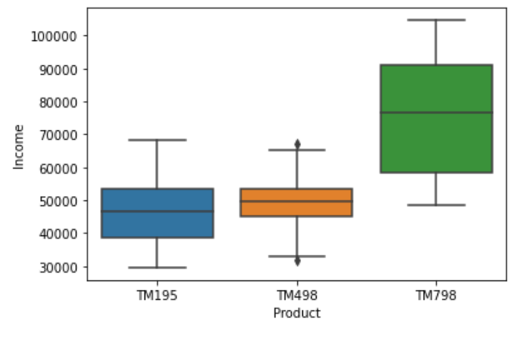
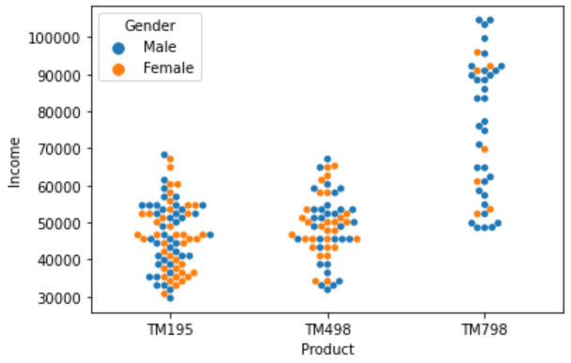
Exploratory Data Analysis Income
Observations:
TM798 has a smaller age range (23 - 37 yrs) with some outliers (40 – 47 yrs).
TM195 & TM498 has a wider range from 18 to 47 yrs.
Buyers of TM798 have a higher income range with an average income of 76K, whereas buyers of TM195 & TM498 have comparatively lower average income.
Scatterplot shows that as the age increases, income is likely to be high. This indicates that a buyer with higher age and a higher income is most likely to buy TM798.
Males have higher income than Females and so are more likely to buy TM798.

Slide 8
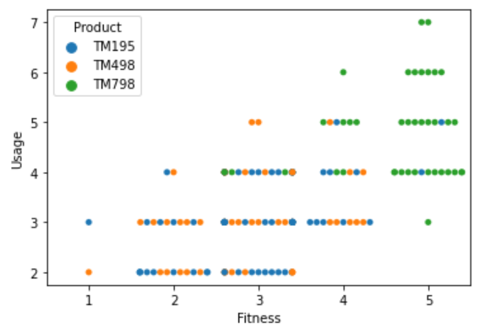
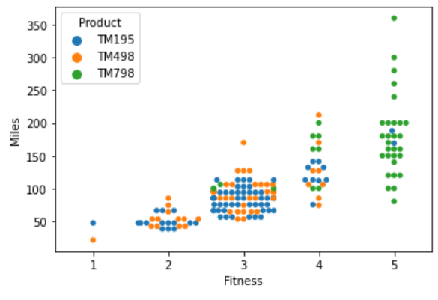
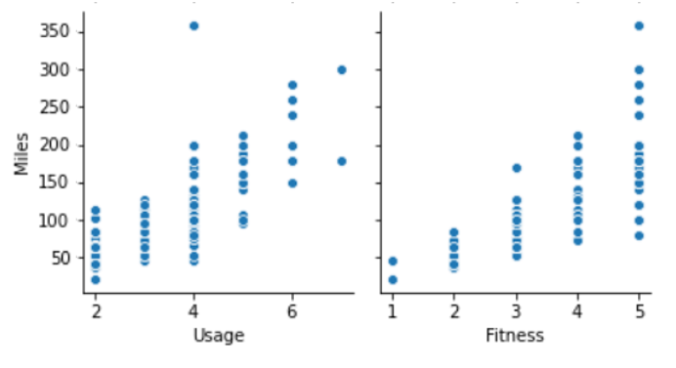
Exploratory Data Analysis - In this data, there are variables like Fitness and Usage that affect customer’s preferences of treadmill product.
Observations:
Customers with high fitness rate and high usage prefer to use TM798.
TM195 & TM498 are normally preferred by customers with average fitness rate and moderate usage.
Fittest customers plan to run more miles when compared to customers with average fitness rate.
Customer with high fitness rate use treadmill more times in a week.

Slide 9
Conclusions & Recommendations
Conclusions
TM195
Most preferable by customers (both Male & females)
Affordable to customers with below average income.
Customers using TM195 are moderately fit and they use the machine 2-4 times a week.
TM498
Less preferable from TM195 with a smaller customer base.
Preferred by customers with below average income and moderate fitness.
TM798
Small customer base with majority of Males.
A premium product preferred by customers with higher avg. income, high fitness rate, more usage (4-7 times a week).
In general, Partnered customers are more likely to buy treadmills as compared to Single ones.
Recommendations
Male buyers with high income range are potential customers for TM798.
Partnered customers can be targeted for increasing the customer base.
It’s worth exploring how can we increase customer base for TM498 by comparing it with TM195 features, as customer profiles for both TM195 & TM498 are similar.
Customers with age > 40 yrs are more likely to have higher income. Fitness is a need in such age and so there are extremely high chances for them to buy TM798.

